Slide 1

Youtube Channels Analysis
By Prashanth Jatevath

Slide 2
Problem Definition
In today's rapidly evolving digital landscape, YouTube has emerged as a dominant platform for content dissemination and monetization. With millions of content creators and billions of views daily, understanding the dynamics of earnings on YouTube can offer valuable insights for both creators and advertisers.
Can we predict a YouTube channel's Average Yearly Earnings based on channel metrics and attributes?

Slide 3
Obejctives
primary aim is to:
Predict the Average Yearly Earnings of a YouTube channel based on various channel attributes and metrics.
Build a data-driven model that can accurately determine potential earnings, allowing creators to strategize their content and for advertisers to identify lucrative collaboration opportunities.

Slide 4
Key Challenges:
Data Complexity: YouTube channels can be diverse - from music, education to vlogs. This diversity means a wide range of data points to consider.
Data Cleaning and Preprocessing: Handling missing values, outliers, and encoding categorical variables to ensure a consistent dataset for modeling.
Feature Importance: Not all metrics have equal significance. Identifying the right set of features that most impact earnings is crucial for an accurate model.

Slide 5
Dataset
Obtained from Kaggle
Key Features:
Channel Metrics: Video views, subscriber count, video uploads, etc.
Channel Attributes: Channel type, country of origin, creation date, etc.
Earnings: Monthly and yearly earnings estimates.
Total Records:
Contains data for over 900 YouTube channels. (Replace X with the actual number of records/samples)
Objective:
With these features, our goal is to predict the Average Yearly Earnings of a YouTube channel, assisting creators and advertisers in making informed decisions.

Slide 6

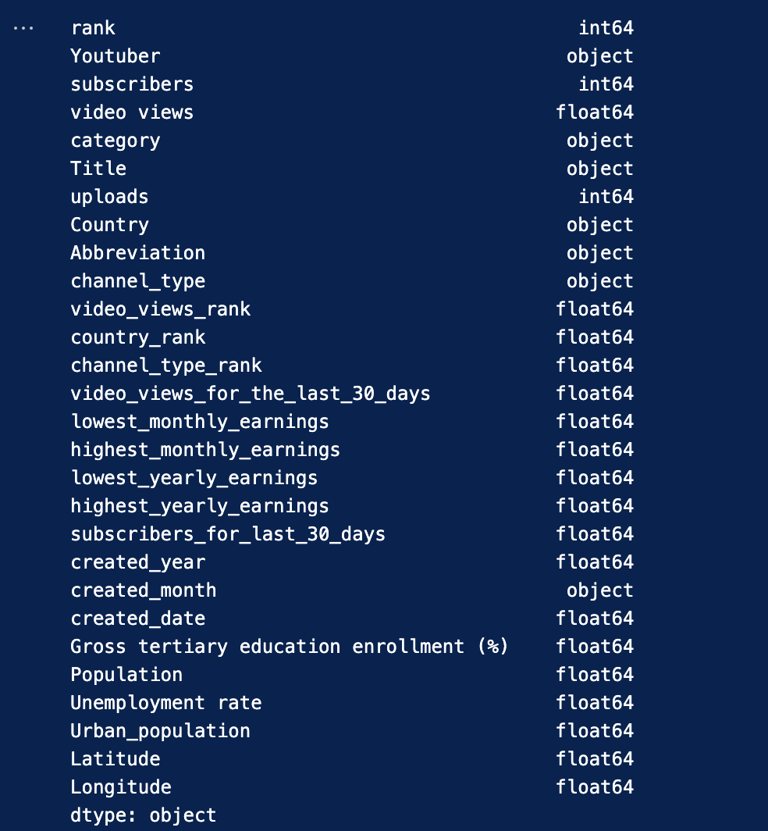
Dataset Continued

Slide 7

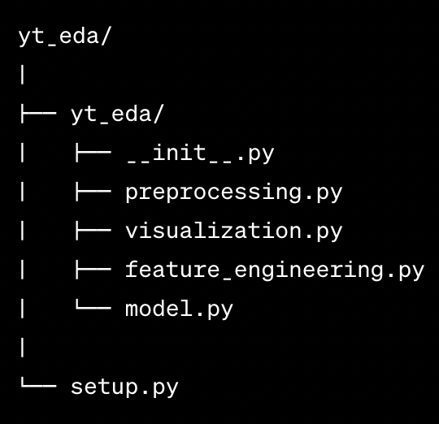
Library Overview
Objective:
Designed to automate the end-to-end process of YouTube channel data preprocessing, visualization, feature engineering, and model building.
Key Components:
Preprocessing: Handle missing values, encoding of categorical features, etc.
Visualization: Analyze distributions, relationships, and feature importance.
Feature Engineering: Extract relevant features to improve model accuracy.
Model: Predict the Average Yearly Earnings of a YouTube channel.

Slide 8
Preprocessing Module
Functions:
Filling missing values based on strategic imputation techniques.
Conversion of date-related columns to a unified datetime format.
Categorical encoding without dimension expansion.
Outcome:
A dataset ready for visualization and model building.

Slide 9
Visualization Module
Before Preprocessing:
Distribution of numeric and categorical data.
Relationships between channel type and category.
After Preprocessing:
Heatmap for feature correlation.
Scatter plots for feature relationships.
Feature importance using Random Forest.

Slide 10
Feature Engineering Module
Functions:
Removal of low-importance features.
Generation of 'average_yearly_earnings' from high and low yearly earnings.
Dropping redundant columns.
Outcome:
A dataset optimized for prediction with the most significant features.

Slide 11
Model Module
Algorithm:
RandomForestRegressor
Evaluation Metrics:
Mean Squared Error (MSE) for regression accuracy.
R^2 Score to gauge the explanatory power of the model.
Result:
Model's ability to predict a channel's average yearly earnings with a certain accuracy.

Slide 12

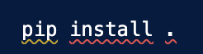
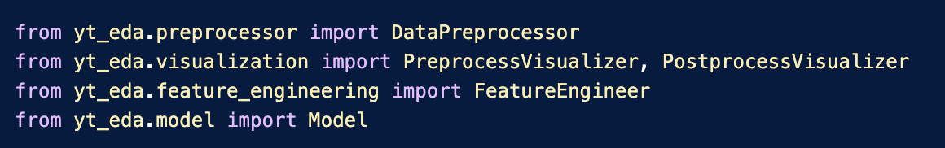
Install & import

Slide 13

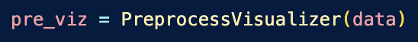
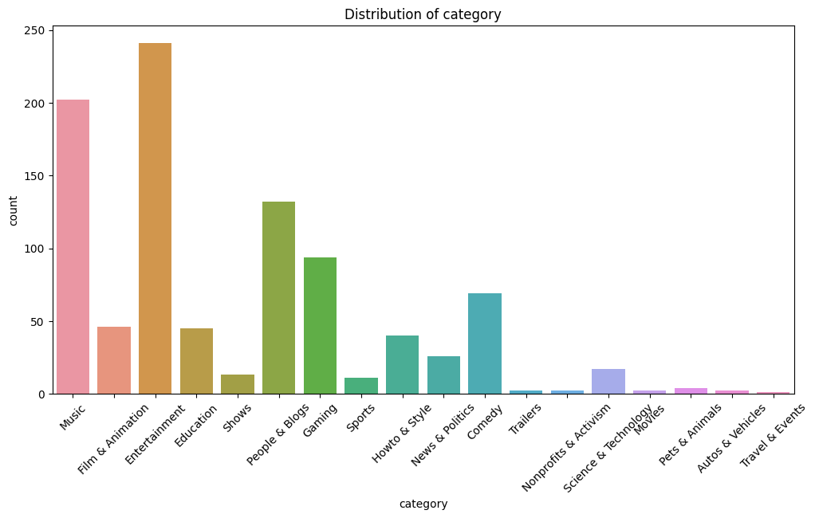
Count of categories

Slide 14
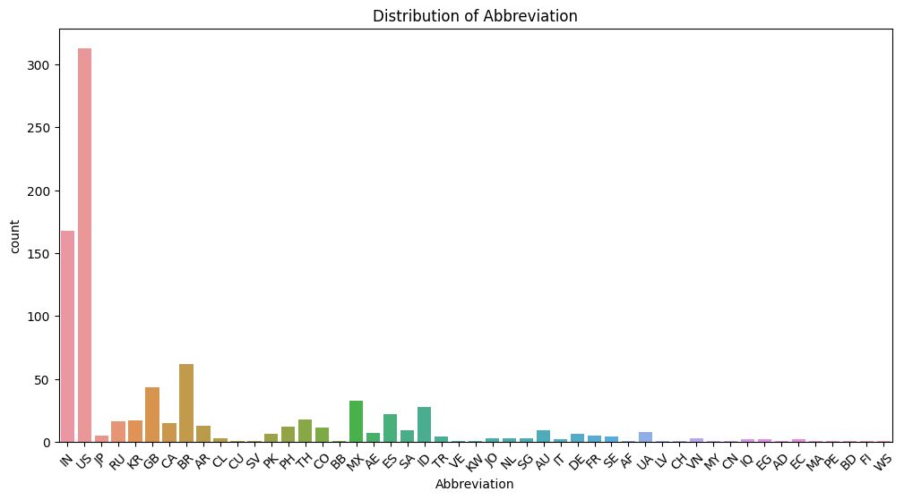
Channel counts per country

Slide 15
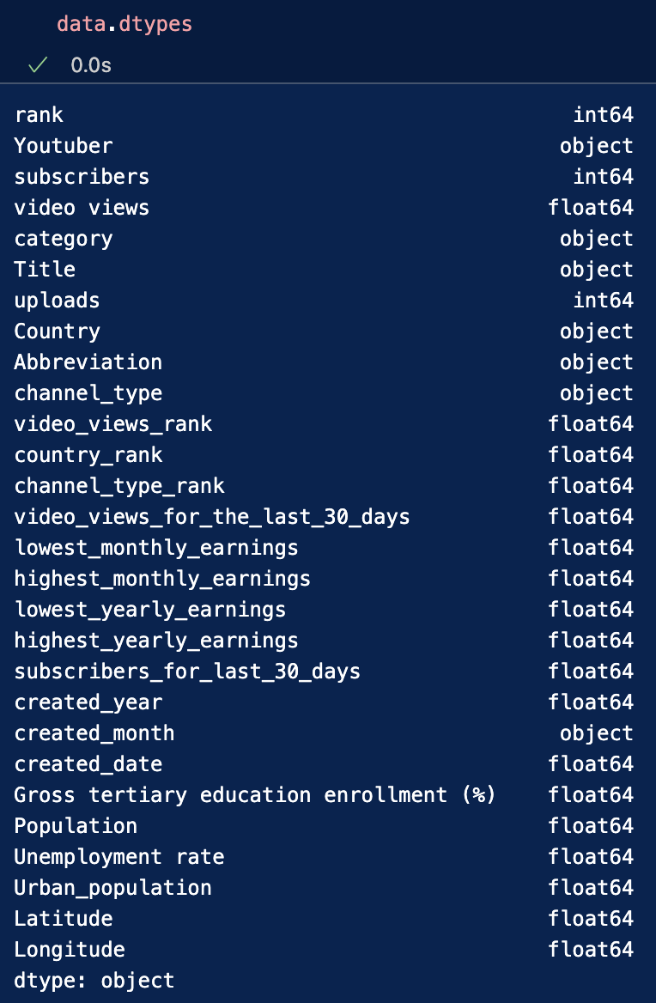
Pre-processing

Slide 16
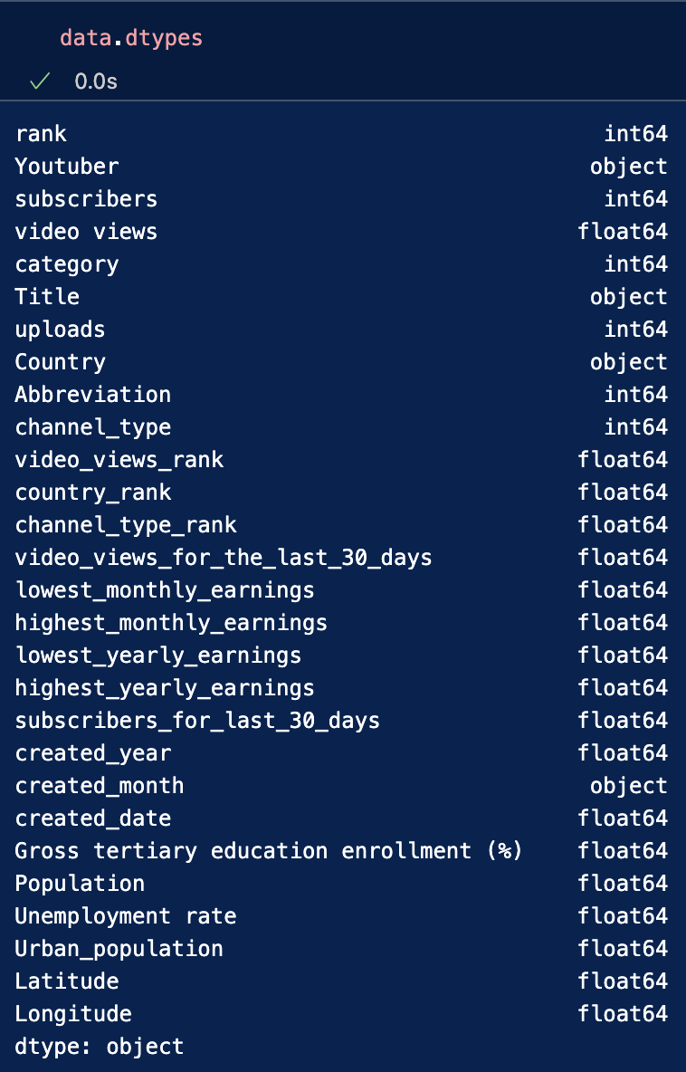
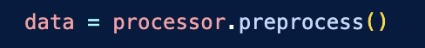
PreProcessing

Slide 17
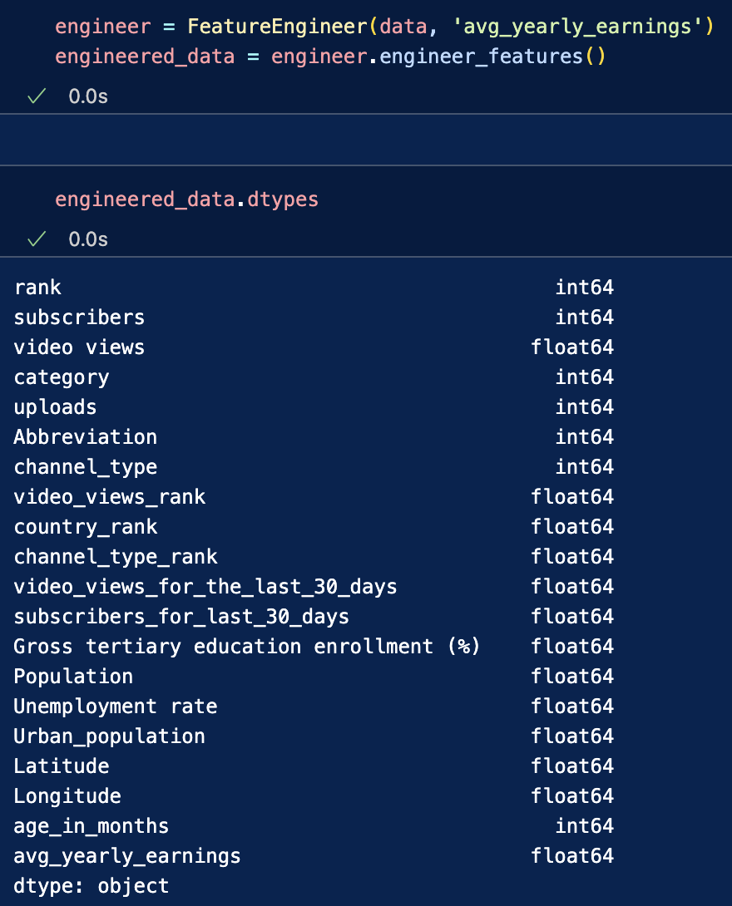
Feature Engineering

Slide 18
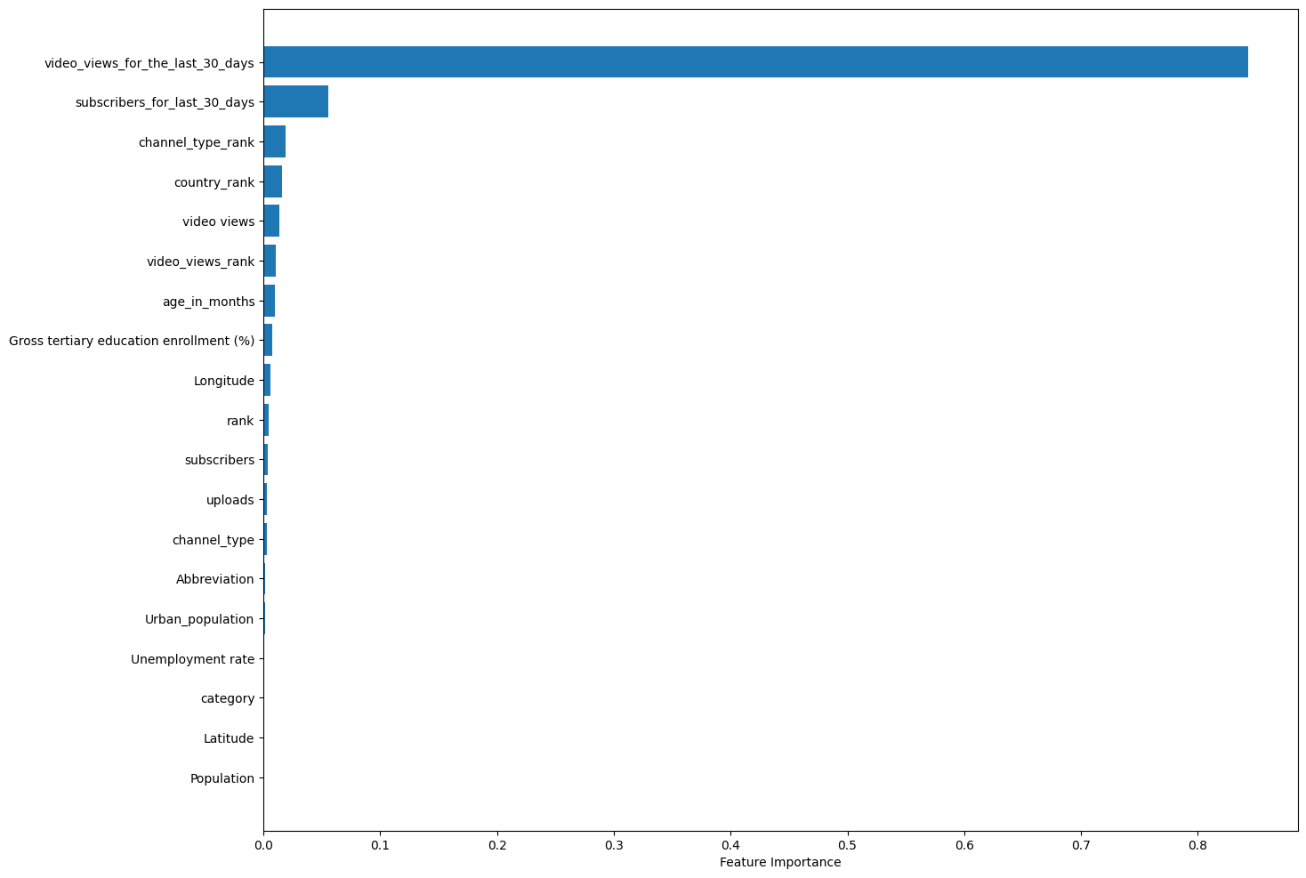
Feature Importance

Slide 19

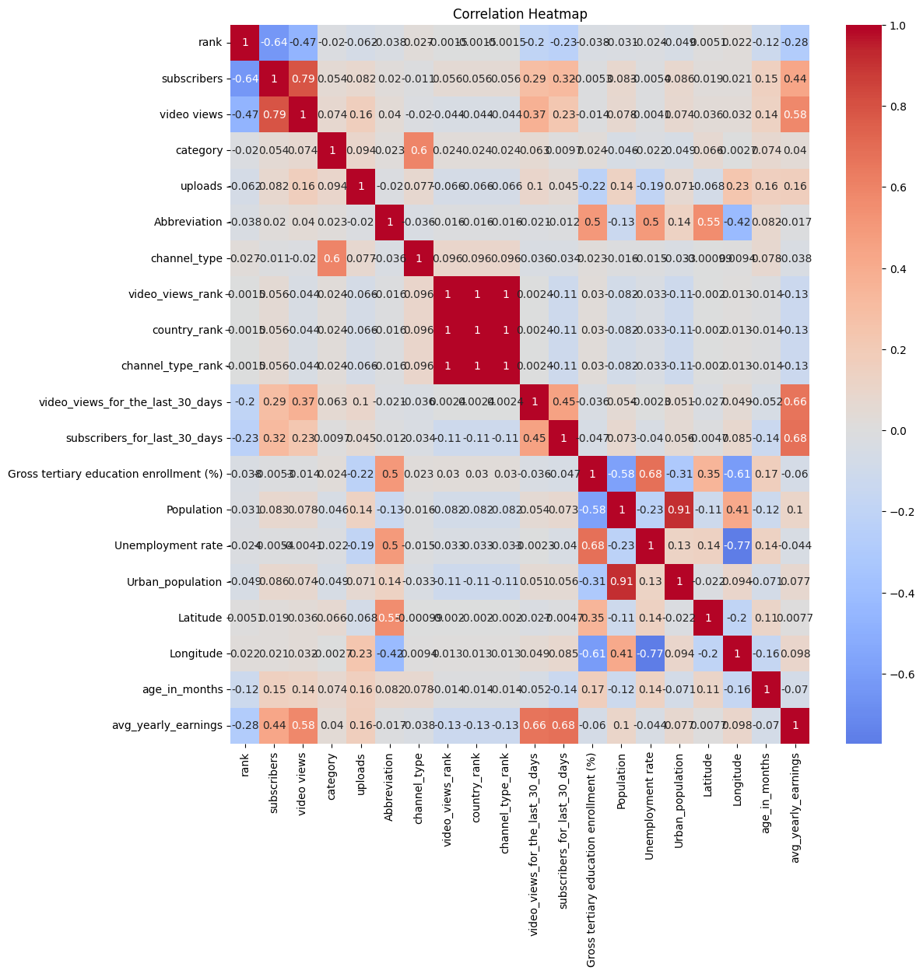
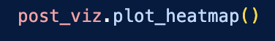
heatmap

Slide 20

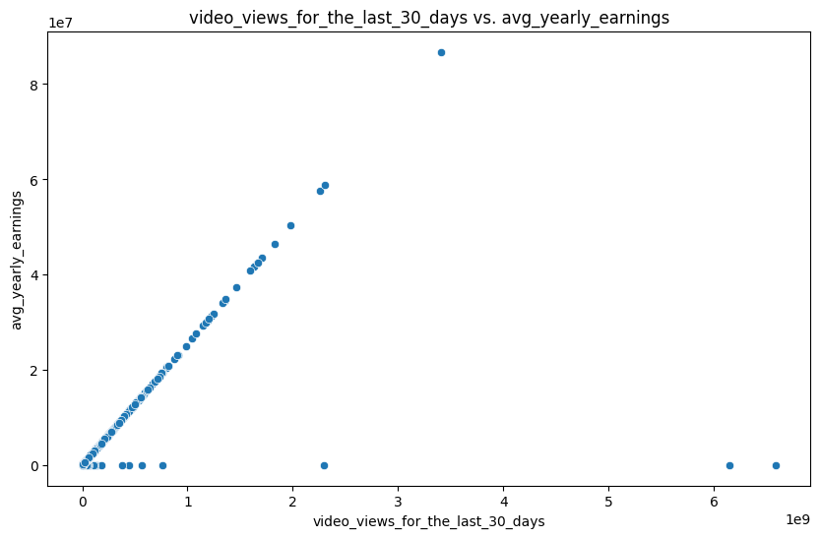
EDA continued

Slide 21
Model
Regression problem (prediction of average yearly earnings)
Chosen Model: RandomForestRegressor
Why?
Versatility: Can handle both categorical and numerical data.
Feature Importance: Easily provides insights into the significance of each feature.
Non-linear: Capable of capturing complex relationships in the data.

Slide 22
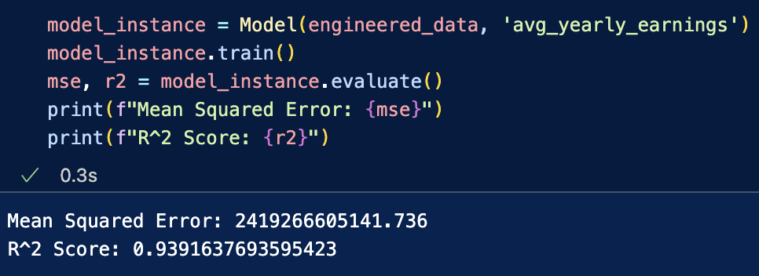
Model results

Slide 23

Thank you

